Slide 1
Automation Framework using Cypress
3-Sept-2024

Slide 2
Index
Problem Statement
Automation Scope
Outcomes and Improvements – After Automation
Demo
Sample Report
Roadmap
Q/A

Slide 3
Problem Statement
Problem Area | Challenges
Time-Consuming | Manually running scripts can be extremely time-consuming, especially as the number of scripts increases, during multiple browsers and testing in various viewports and on various devices. Each page needs to be scanned manually for accessibility testing, which is a time-consuming task. Each test case needs to be executed step-by-step, which slows down the testing process.
Error-Prone | Human error is a significant risk in manual testing. Inconsistent execution due to varying interpretations of test cases by different testers.
Inefficiency | Manual testing is repetitive and can lead to tester fatigue. Testing the same functionality repeatedly for different builds or versions is inefficient.
Limited Coverage | Due to time constraints, not all test cases can be executed manually. This often results in incomplete testing and potential undetected defects.
Resource Intensive | Requires a significant number of human resources to execute tests manually.

Slide 4
Automation Scope
Category | Details
Broken links health Check | Automate the broken link health check for all pages
Page Validation | Validate each broken link redirect to the expected page
Functionalities | Quote retrieval using various zip codes on multiple screens Login functionality Contact Us etc.…
Multi Browser Execution | Execute automation scripts in multiple browsers (Chrome, Edge, Safari)
Multiple Devices | Use viewport settings in Chrome Browser for testing on various devices to ensure compatibility across devices
Accessibility Testing | Conduct Axe scans on all screens
Parallel Execution | Utilize GitHub Concourse for parallel execution
Reporting | Generate consolidated reports (Excel) and leadership reports (HTML) Automatic email for reporting to stakeholders after execution

Slide 5
Outcomes and Improvements
Resolution | Outcomes
Speed and Efficiency | Automated tests execute faster than manual tests. Multiple tests in parallel, reducing overall testing time. Frees up testers to focus on more complex, exploratory testing
Accuracy and Consistency | Automation eliminates the risk of human error. Tests are executed in a consistent manner every time.
Improved Test Coverage | Allows for the execution of a large number of test cases. Facilitates thorough testing of all aspects of the application.
Release Confidence | Comprehensive testing across browsers, devices, and accessibility compliance build higher confidence in release quality
Cost-Effective in the Long Run | Initial investment in automation tools and scripts can be high, but it reduces long-term costs.

Slide 6
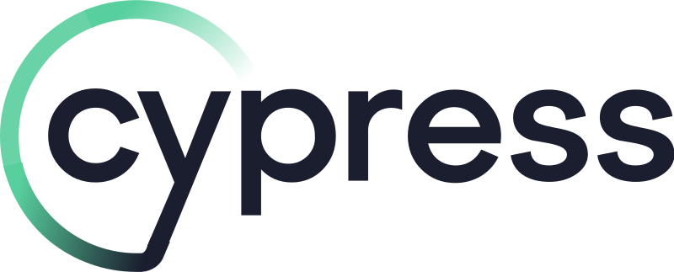








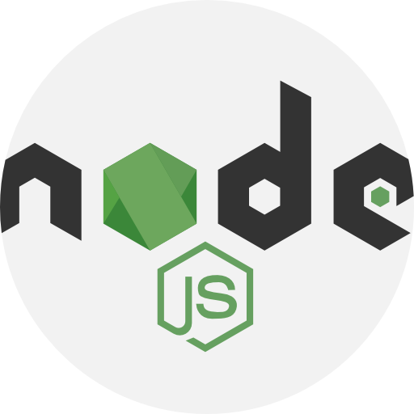




Framework Demo & Architecture Diagram
Continuous Integration (CI Servers)
Test Management
Run Scripts (runner.js)
Build
Test Cases/ User Stories
Run/ Initiate Tests
Test Suites
Config File
(Cypress.json)
Master (master.cy.js)
Fixtures
Test Execution
Repository
Input Test Data
Object Repository
Reporting
Application Under Test (AUT)
Web
Mobile

Slide 7
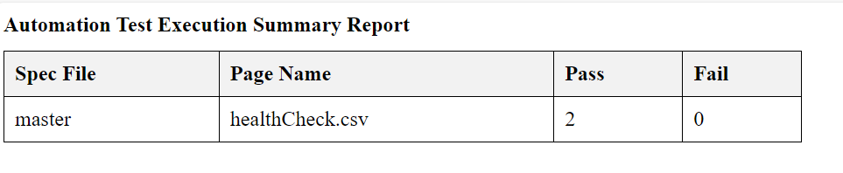
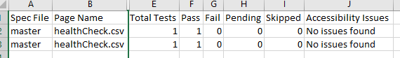
Sample Reporting
High level Report (HTML)
Consolidated Detailed Report format (Excel)

Slide 8
Roadmap
Quarter | Milestones | Details | Status
Q2 2024: Planning & Initial Setup | Framework Selection | Choose and set up Cypress for automation testing. Integrate Axe for accessibility testing. | Completed
 | Define Objectives and Scope | Identify key functionalities and pages for health checks. Determine browsers and devices for multi-browser and multi-device testing. | Completed
 | Reporting | Develop consolidated Excel reports and HTML leadership reports. Implement automated email notifications for stakeholders. | Completed
Q3 2024: Development & Integration | Script Development | Develop and validate scripts for URL health checks and screen validations. Implement quote retrieval and login functionality tests. | In Progress
 | Multi-browser & Multi-device Testing | Configure and test scripts across Chrome, Edge, and Safari. Implement viewport settings for various device simulations. | In Progress
Q3 2024: Development & Integration | Environment Setup | Configure GitHub Concourse for CI/CD pipeline. | In Progress
 | Parallel Execution | Set up parallel execution using GitHub Concourse to optimize testing time. | Not Started
 | Testing and Debugging | Conduct thorough testing and debugging of scripts. Ensure stability and reliability across different environments. | In Progress
 | Stakeholder Reviews | Conduct reviews with stakeholders to gather feedback. Iterate and improve the automation framework based on feedback. | In Progress
Q4 2024: Implementation & Continuons Improvement | Full Rollout | Deploy the automation framework for Interstellar. Start utilizing the automation for regression and smoke testing during production deployment in various environments | Not Started
Q4 2024: Full Implementation & Continuous Improvement | Continuous Improvement | Monitor and refine the framework based on ongoing usage and feedback. Keep up with Cypress updates and best practices to maintain efficiency. | Not Started
2025: Implementation | Implement the Framework in other Business lines | Demo, setup and implement the framework for other business lines. Provide training to various teams | Not Started

Slide 9


